Slide 1





AWS CLOUD NETWORKING
VPC, Subnets, Route Tables,
Internet Gateway & NAT Gateway
A hands-on foundation guide for freshers starting their cloud engineering journey
Cloud Networking Training Deck

Slide 2
AGENDA
What We'll Cover Today
Five building blocks every AWS network is made of
1. Virtual Private Cloud (VPC)
Your own isolated network space inside AWS
2. Subnets
Smaller IP ranges that divide your VPC across availability zones
3. Route Tables
The rules that decide where network traffic is allowed to go
4. Internet Gateway (IGW)
The bridge that connects your VPC to the public internet
5. NAT Gateway
Lets private resources reach the internet without being exposed
AWS Cloud Networking
2

Slide 3
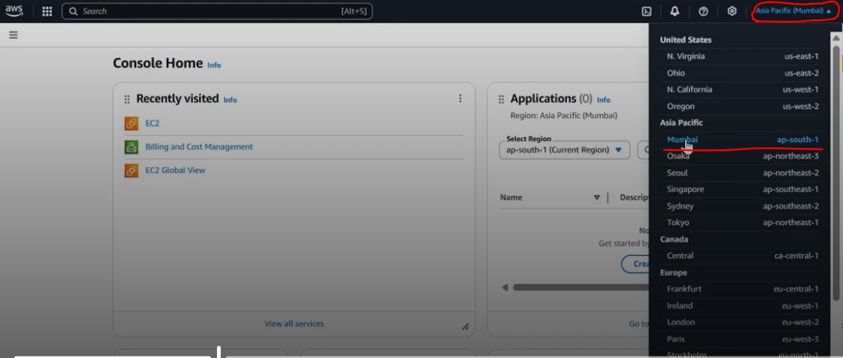
GETTING STARTED
Every Deployment Starts With a Region
Before creating any network, AWS asks you where in the world to build it
A Region is simply a datacenter location (e.g. Mumbai, US East) — a collection of servers AWS manages for you.
Choose the region closest to your customers — a US-based customer is served better from a US region, an Indian customer from Mumbai.
Inside a chosen region, you create a VPC — and everything else (subnets, gateways, servers) lives inside that VPC.
Why bother with private networking at all? So nothing is exposed to hackers by default — you decide exactly what the internet can reach.
Selecting an AWS Region before creating resources
The hierarchy: Region → VPC → Availability Zone → Subnet
AWS Cloud Networking
3

Slide 4
TOPIC 1 · VPC
What Is a VPC?
Virtual Private Cloud — your own private slice of the AWS network
A VPC lets you launch AWS resources inside a network that you define and fully control — your own IP address range, subnets, route tables and gateways — completely isolated from every other customer on AWS.
THINK OF IT LIKE THIS
KEY FACTS
A VPC is like your own gated housing society inside a big city (AWS). You decide the internal roads (subnets), who can enter the gate (Internet Gateway), and the traffic rules (route tables) — the rest of the city can't just walk in.
You define an IP address range using CIDR notation (e.g. 10.0.0.0/16)
Every other AWS resource (subnets, servers, gateways) is created inside a VPC
VPCs are private and isolated by default — nothing is public until you configure it
Shared cab vs. dedicated cab:
Choosing "Default" tenancy is like an Ola/Uber shared ride — your VPC runs on shared physical hardware, which keeps cost low. "Dedicated" tenancy is a private cab — dedicated hardware, but a higher price.
AWS Cloud Networking
4

Slide 5
IP ADDRESSING
Legacy IP Addressing — The Class System
Before CIDR, networks were split into fixed-size classes A through E
Class
First Octet Range
Default Mask
Usable Hosts
Used For
Class A
1 – 126
/8
16,777,214
Very large organizations
Class B
128 – 191
/16
65,534
Medium-sized organizations
Class C
192 – 223
/24
254
Small organizations and home networks
Class D
224 – 239
N/A
N/A
Multicasting (one-to-many communication)
Class E
240 – 255
N/A
N/A
Research and experimental purposes
AWS Cloud Networking
19

Slide 6
IP ADDRESSING
Why Did We Move to CIDR?
From wasteful fixed classes to flexible, need-based allocation
Classful addressing used fixed network sizes, which wasted many IP addresses. A company needing 1,000 IP addresses had to use a Class B network with 65,534 usable addresses — using under 2% of the block.
WHY IT MATTERS
KEY TAKEAWAY
Classful addressing forced fixed network sizes, wasting large blocks of address space
A company needing 1,000 IP addresses had to take a full Class B block of 65,534 addresses
CIDR (Classless Inter-Domain Routing) allocates addresses based on actual requirements, reducing wastage and improving scalability
Modern cloud platforms like AWS VPC use CIDR, not Class A, B, or C addressing. CIDR notation (e.g. 10.0.0.0/16) is what you set when creating a VPC or subnet — it defines exactly how many IP addresses you get.
AWS Cloud Networking
20

Slide 7
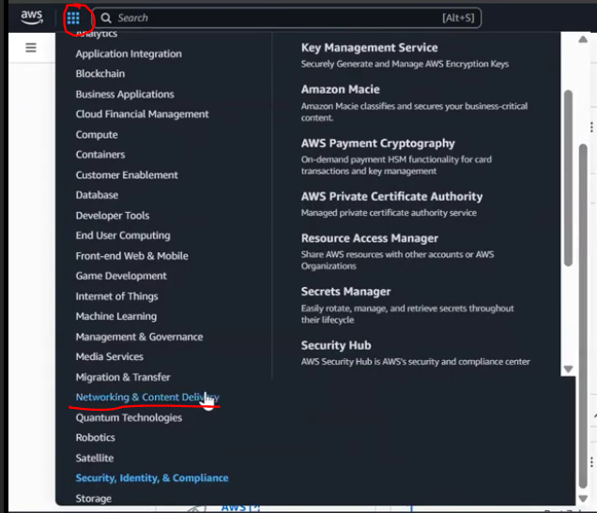
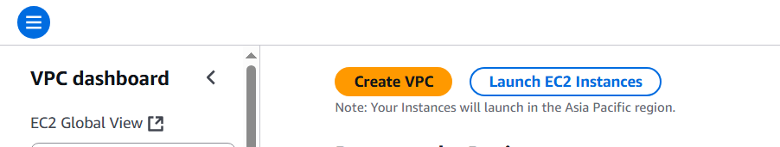
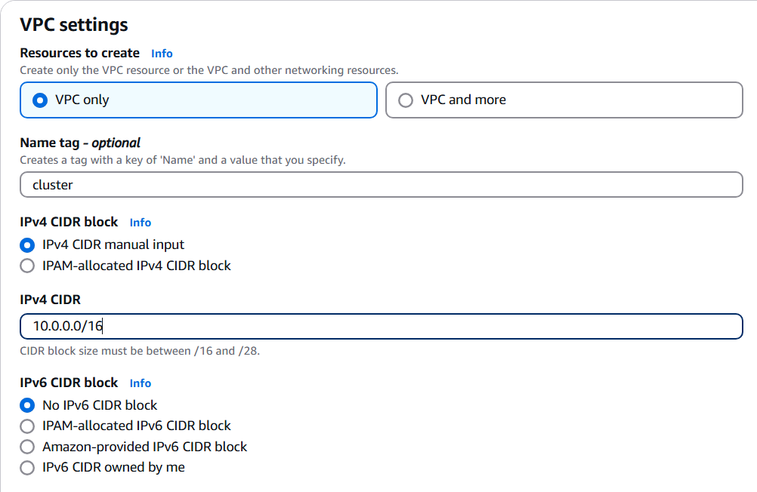
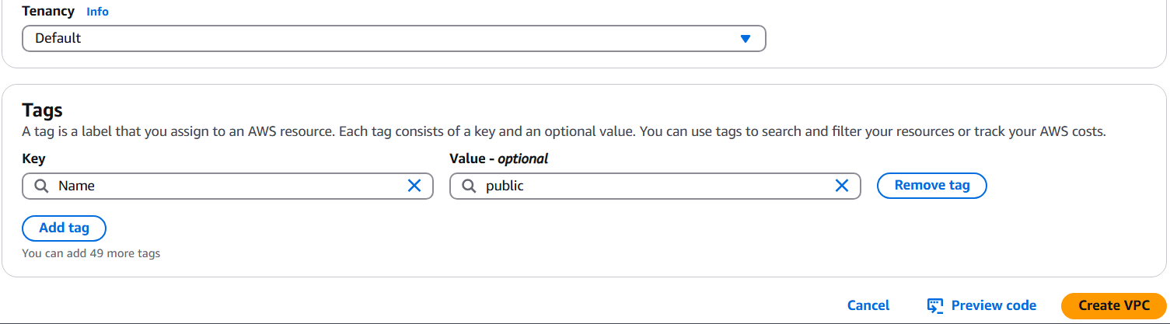
TOPIC 1 · VPC
Creating a VPC — Step by Step
Console walkthrough: Services → VPC → Create VPC
1
Open Services and select Networking & Content Delivery, then click VPC.
Click Create VPC.
Click Create VPC
2
3
Enter a Name tag and an IPv4 CIDR block (your VPC's IP address range).
Open the VPC service
4
Under Tenancy, choose Default (shared hardware, lower cost).
5
Click Create VPC to finish.
Tenancy: Default
Name + IPv4 CIDR block
In real projects: teams rarely click through the console — this is usually automated with a Terraform script.
AWS Cloud Networking
5

Slide 8
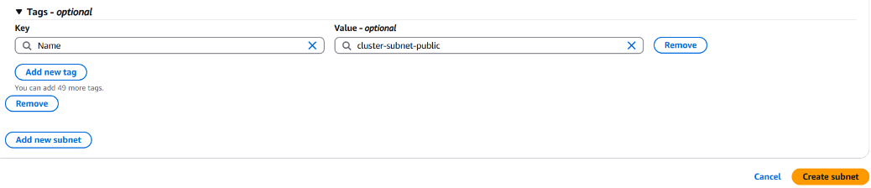
TOPIC 2 · SUBNETS
What Are Subnets?
Dividing your VPC's IP range into smaller, manageable zones
A subnet is a smaller slice of your VPC's IP address range, and it always lives inside one Availability Zone. Inside a subnet, you launch resources such as EC2 servers.
Region
→
VPC
→
Availability Zone
→
Subnet
PUBLIC SUBNET
Attached to an Internet Gateway — reachable from the internet.
PRIVATE SUBNET
Attached to a NAT Gateway — hidden from direct internet access.
A subnet successfully created
AWS Cloud Networking
6

Slide 9
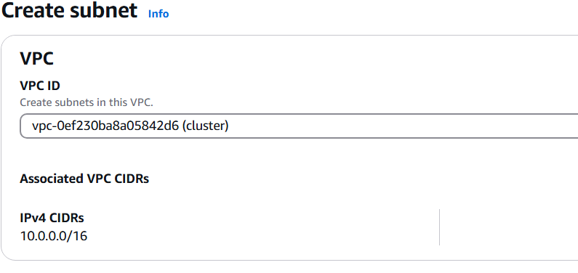
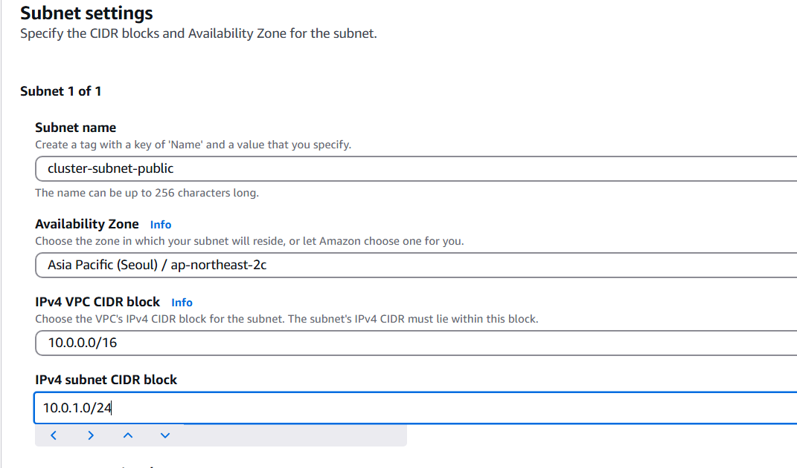
TOPIC 2 · SUBNETS
Creating a Subnet — Step by Step
Console walkthrough: VPC → Subnets → Create Subnet
1
In the VPC console, click Create subnet.
2
Select the VPC you created earlier — the subnet must belong to it.
3
Fill in the subnet name, Availability Zone, and its IPv4 CIDR block.
Choose the parent VPC
4
Click Create subnet to finish.
5
Repeat to create as many public and private subnets as your design needs.
Subnet created
Name, AZ & CIDR block
AWS Cloud Networking
7

Slide 10
TOPIC 3 · INTERNET GATEWAY
What Is an Internet Gateway?
The doorway between your VPC and the public internet
An Internet Gateway (IGW) is a vital component that enables communication between a VPC and the internet. It acts as a bridge, allowing resources in public subnets — like EC2 instances — to connect out to the internet, and to receive connections back.
WHY YOU NEED IT
KEY FACTS
Without an Internet Gateway attached, a VPC has no way to send or receive any traffic from the internet at all — every request to an outside URL, and every visitor trying to reach your website, needs this bridge to exist first.
An IGW is created separately, then attached to a VPC
A subnet becomes "public" only once its route table sends internet-bound traffic to the IGW
One IGW is attached to one VPC at a time
AWS Cloud Networking
8

Slide 11
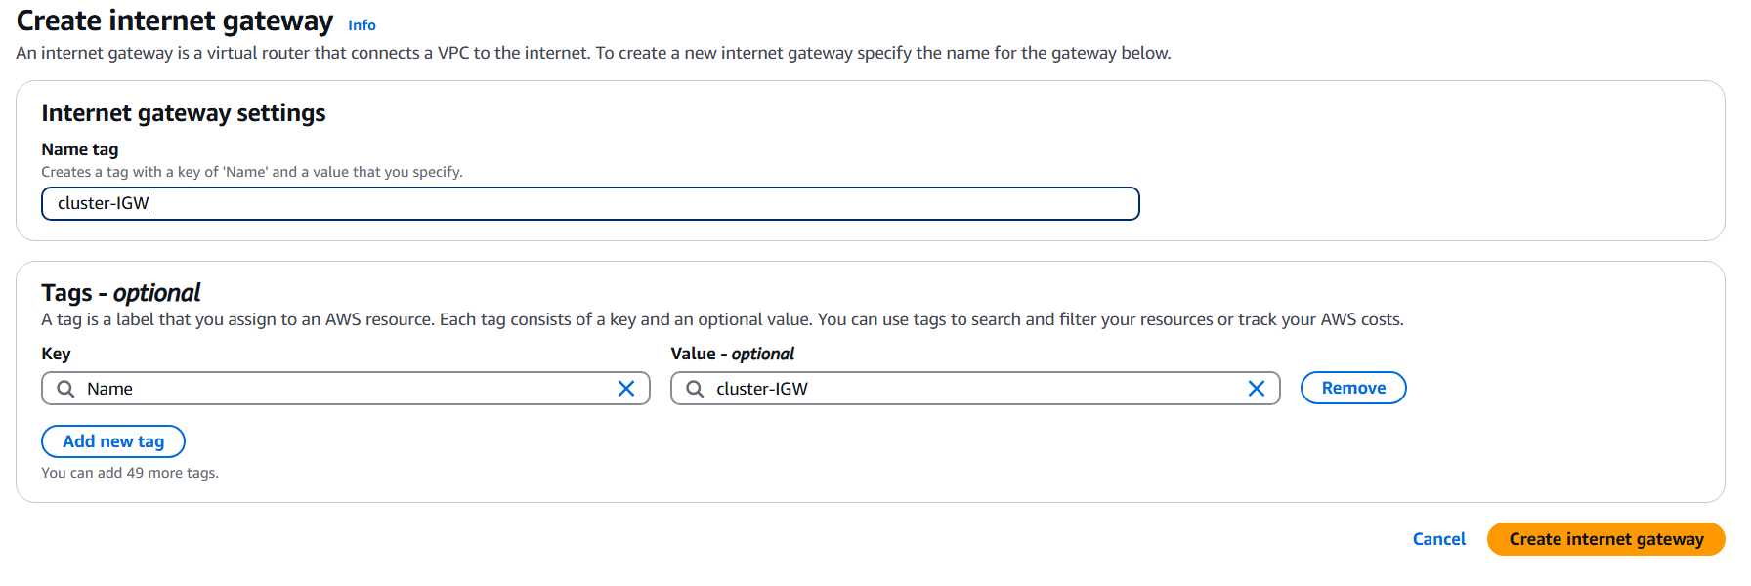
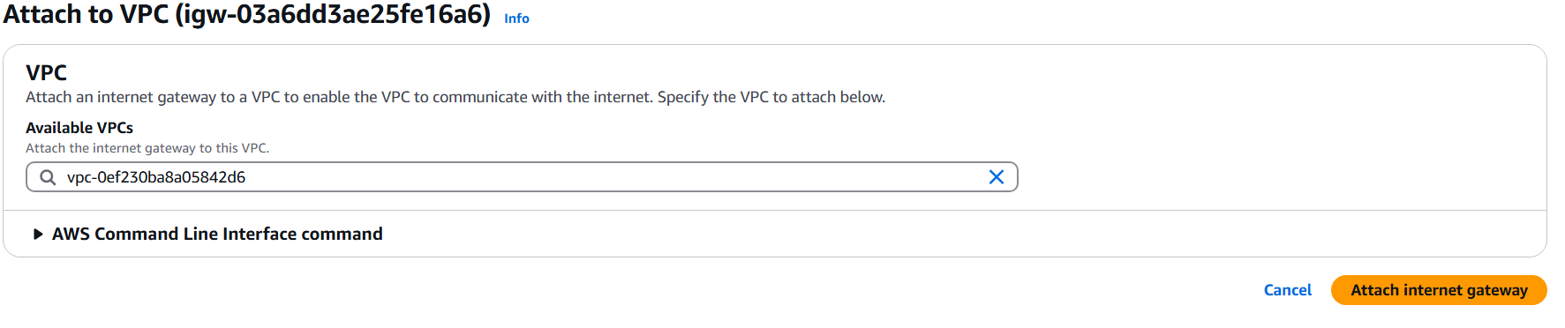
TOPIC 3 · INTERNET GATEWAY
Creating & Attaching an Internet Gateway
Console walkthrough: VPC → Internet Gateways → Create → Attach
1
Go to Internet Gateways and click Create internet gateway.
2
Give it a name, then click Create internet gateway.
3
With the new gateway selected, click Actions → Attach to VPC.
Step 1–2 · Create the internet gateway
4
Choose the VPC you created and confirm.
5
The gateway's state changes to Attached — your VPC can now reach the internet.
Step 3–4 · Attach it to your VPC
AWS Cloud Networking
9

Slide 12
TOPIC 4 · ROUTE TABLES
What Are Route Tables?
The signposts that decide where every packet of traffic is allowed to go
A route table is a set of rules, called routes, that determine where network traffic from your subnet is directed. Every subnet must be associated with exactly one route table.
EXAMPLE ROUTE TABLE (VPC CIDR 10.0.0.0/16)
Destination
10.0.0.0/16
Target
local
Meaning
Traffic within the VPC stays local
HOW A SUBNET BECOMES "PUBLIC"
By default a route table only knows how to reach addresses inside the VPC (the local route). To let a subnet reach the wider internet, you add one more route — destination 0.0.0.0/0 ("anywhere"), target = your Internet Gateway. Any request outside the 10.x range now gets forwarded to the IGW instead of being silently blocked.
AWS Cloud Networking
10

Slide 13
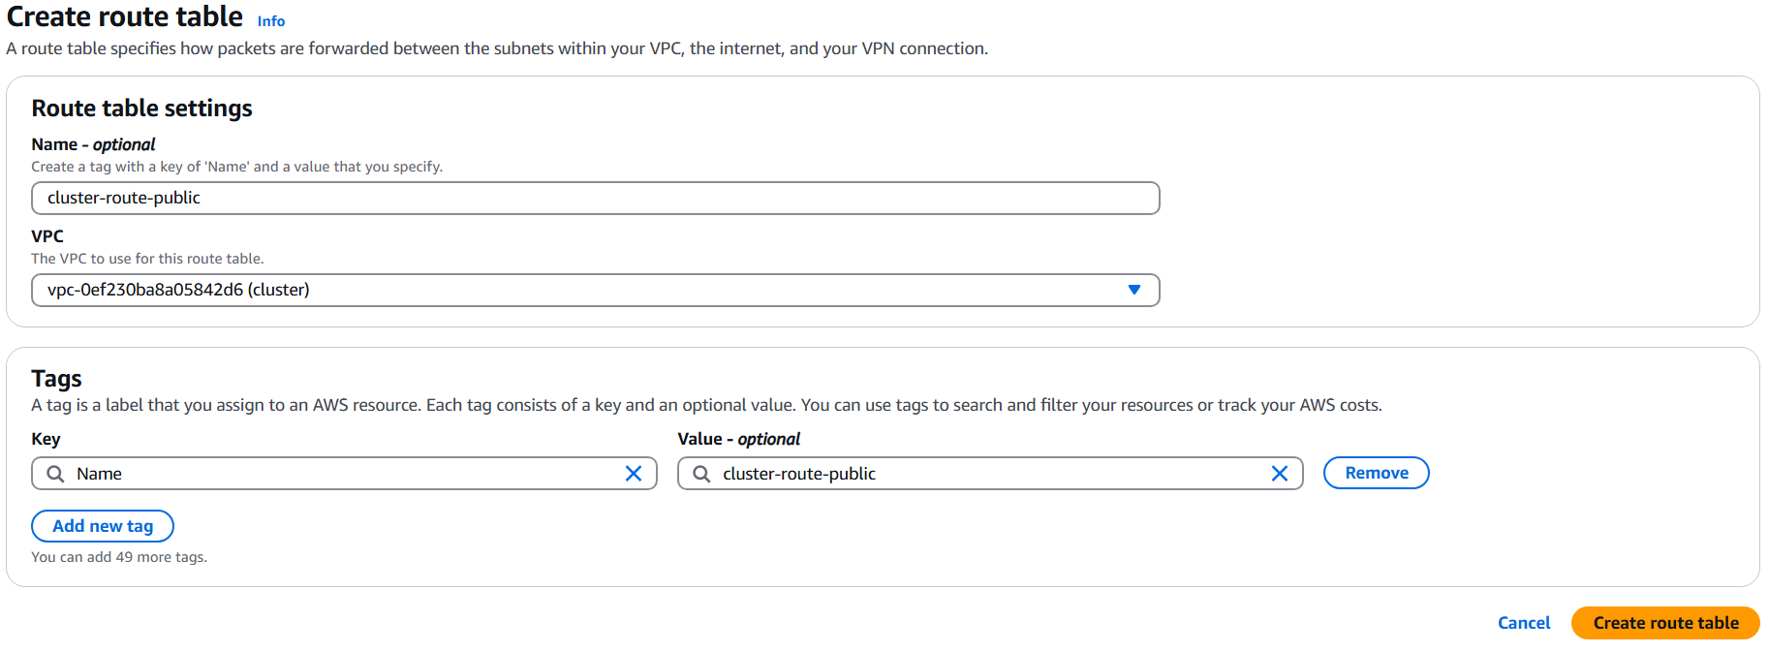
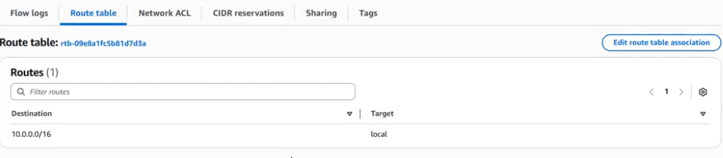
TOPIC 4 · ROUTE TABLES
Creating & Associating a Route Table
Console walkthrough: VPC → Route Tables → Create route table
1
Go to Route Tables and click Create route table.
2
Give it a name and select the VPC it belongs to, then click Create route table.
3
By default it only contains the local route for your VPC's IP range.
4
Any traffic from an IP outside that range is dropped — until you add a route for it.
Create the route table for your VPC
5
Next: associate this table with your subnet, and add an internet route.
The default local route (10.0.0.0/16 → local)
AWS Cloud Networking
11

Slide 14
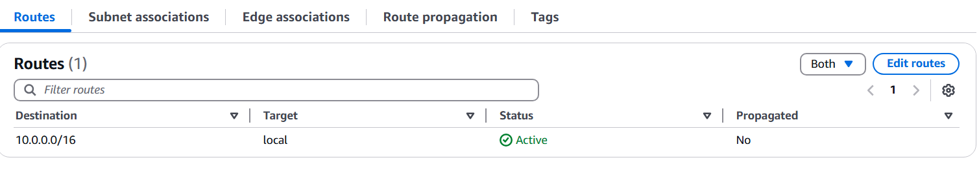
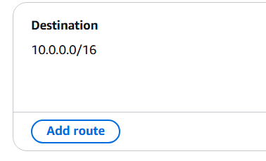
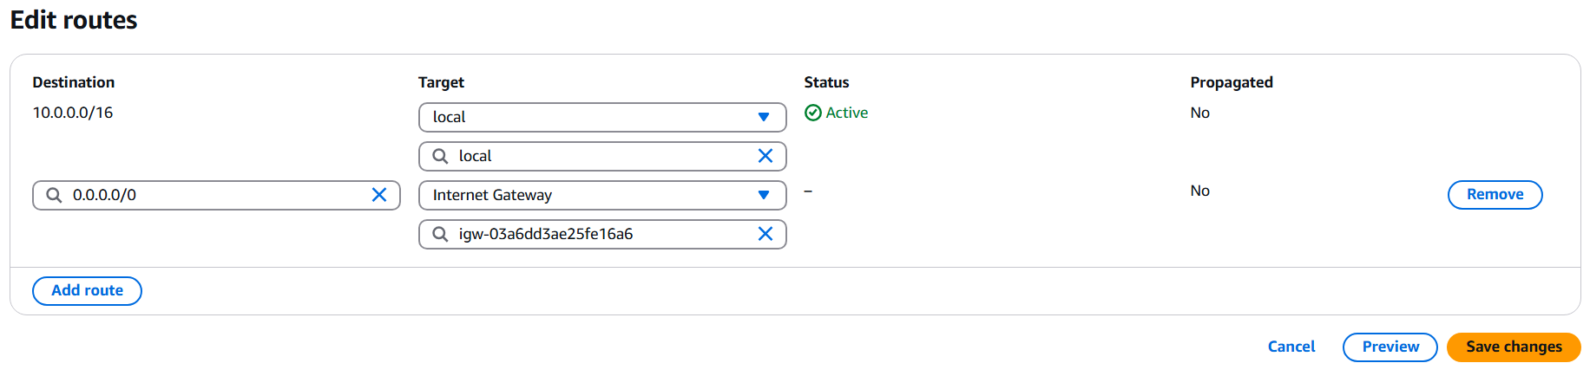
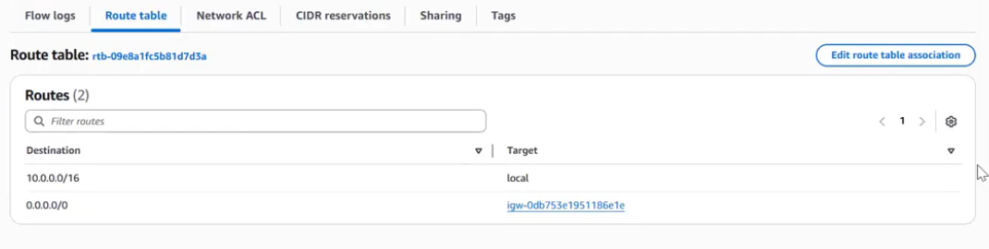
TOPIC 4 · ROUTE TABLES
Adding the Internet Route
This one extra rule is what turns a subnet public
1
Open the route table and click Edit routes.
2
Click Add route.
Click Edit routes
3
Set Destination to 0.0.0.0/0 and Target to your Internet Gateway, then Save changes.
4
Go back to the subnet and associate it with this route table.
Click Add route
0.0.0.0/0 → Internet Gateway
5
The subnet's route table now shows the new rule — it is officially public.
Subnet now shows the internet route — it's public
AWS Cloud Networking
12

Slide 15
TOPIC 5 · NAT GATEWAY
What Is a NAT Gateway?
Outbound internet access for private subnets — without exposing them
If a subnet's route table sends internet traffic to a NAT Gateway instead of an Internet Gateway, that subnet stays private. A NAT Gateway lets servers inside it start outbound connections (e.g. downloading updates) while blocking anyone on the internet from initiating a connection in.
Good to know: a NAT Gateway itself is created inside a public subnet and needs its own Elastic (fixed) IP address — private subnets then route their internet-bound traffic to it.
PUBLIC SUBNET PATH
PRIVATE SUBNET PATH
EC2 Server → Route Table (0.0.0.0/0) → Internet Gateway → Internet
EC2 Server → Route Table (0.0.0.0/0) → NAT Gateway → Internet Gateway → Internet
Two-way: the server can be reached directly from the internet (e.g. a public website).
One-way only: the server can reach out, but nobody on the internet can reach in directly.
AWS Cloud Networking
13

Slide 16
RECAP
Public Subnet vs. Private Subnet
The same five building blocks, compared side by side
Public Subnet
Private Subnet
Internet route target
Internet Gateway
NAT Gateway
Reachable directly from internet?
Yes
No
Can it start outbound connections?
Yes
Yes
Typical use
Web servers, load balancers
Databases, app/backend servers
Attached to route table rule
0.0.0.0/0 → igw-xxxx
0.0.0.0/0 → nat-xxxx
AWS Cloud Networking
14

Slide 17

RECAP
Internet
How It All Fits Together
One VPC, two subnets, and the components that connect them to the internet
Internet
Gateway
VPC 10.0.0.0/16
PUBLIC SUBNET
EC2
Web Server
Route Table
0.0.0.0/0 → IGW
NAT
Gateway
PRIVATE SUBNET
EC2
App / DB
Route Table
0.0.0.0/0 → NAT
AWS Cloud Networking
15

Slide 18
ANALOGY
The Campus Analogy, Visually
Same idea, mapped to how AWS actually routes traffic
University (AWS)
VPC (Campus)
Internet Gateway
(Main Gate)
Public Building
Private Building
Internet
(Subnet)
(Subnet)
Route Table (Roads)
NAT Gateway (Staff Exit Gate)
AWS Cloud Networking
18

Slide 19
ANALOGY
AWS Networking — A University Analogy
Mapping each AWS building block to a familiar campus scenario
AWS Component
University Example
Purpose
VPC
University Campus
Your own private and isolated network.
Subnet
Buildings (Library, Admin Block, Classrooms)
Divides the campus into different sections.
Route Table
Campus Roads
Decides how to travel between buildings or outside the campus.
Internet Gateway
Main Entrance Gate
Allows people (internet traffic) to enter and leave the campus.
NAT Gateway
Staff Exit Gate
Allows staff (private servers) to go outside, but outsiders cannot enter through it.
AWS Cloud Networking
17

Slide 20
SUMMARY
Key Takeaways
Five ideas to remember before you build your first network
VPC
Subnet
Route Table
Internet Gateway
NAT Gateway
Your private, isolated network in AWS — everything else is built inside it.
A smaller IP range within one Availability Zone — public or private.
The rulebook that decides where each subnet's traffic is allowed to go.
Attach it to the VPC, route to it, and a subnet becomes public.
Gives private subnets outbound-only internet access, safely.
AWS Cloud Networking
16

Slide 21
Thank You
Questions & Discussion
AWS Cloud Networking · VPC · Subnets · Route Tables · Internet Gateway · NAT Gateway

